Slide 1
HTML & CSS Course Lecture No-6 By Tariqul Islam Shuvo

Slide 2

CSS3
CSS3 Transforms
Transforms is a power commanding officer under him there are four soldier. One soldier is specialist for one task.
Translate
Skew
Rotate
Scale

Slide 3
CSS3
CSS3 transforms allow you to translate, rotate, scale, and skew elements. A transformation is an effect that lets an element change shape, size and position.
Translate
The translate() method moves an element from its current position(
according to the parameters given for the X-axis and the Y-axis).
Example:
transform: translate(250px)
Skew
The skewX() method skews an element along the X-axis by the given angle.
The skewY() method skews an element along the Y-axis by the given angle.
Combined
The skew() method skews an element along the X and Y-axis by the given angles.
Example:
transform: skew(40deg);

Slide 4
CSS3
Rotate
The rotate() method rotates an element clockwise or counter-clockwise according to a given degree. Using negative values will rotate the element counter-clockwise.
Example:
transform: rotateY(180deg);
Scale
The scale() method increases or decreases the size of an element (according to the parameters given for the width and height).
Example:
transform: scale(1.5);

Slide 5
CSS3
CSS3 Transition
CSS3 transitions allows you to change property values smoothly (from one value to another), over a given duration. To create a transition effect, you must specify two things:
the CSS property you want to add an effect to
the duration of the effect
Note: If the duration part is not specified, the transition will have no effect, because the default value is 0.
The transition-timing-function property specifies the speed curve of the transition effect.
ease - specifies a transition effect with a slow start, then fast, then end slowly (this is default)
linear - specifies a transition effect with the same speed from start to end
ease-in - specifies a transition effect with a slow start
ease-out - specifies a transition effect with a slow end
ease-in-out - specifies a transition effect with a slow start and end

Slide 6

CSS3
CSS3 Shadows
Box Shadow
box-shadow: 10px 10px 5px #888888;
Example:
Text Shadow
text-shadow: 10px 10px 5px #888888;
This value represent the shadow of bottom of the box.
This value represent the shadow color of the box.
This value represent the shadow of right side of the box.
This value represent the shadow size of the box.
This value represent the shadow of bottom of the text.
This value represent the shadow color of the text.
This value represent the shadow of right side of the text.
This value represent the shadow size of the text.

Slide 7
CSS3
Let’s Practice

Slide 8
CSS3
CSS3 Multiple Columns
The CSS3 multi-column layout allows easy definition of multiple columns of text - just like in newspapers:
column-count: value;
column-gap: value;
column-rule-style: solid;
column-rule-width: 1px;
column-rule-color: lightblue;
column-rule: 1px solid lightblue;
column-width: 100px;

Slide 9
CSS3
CSS3 User Interface
CSS3 has new user interface features such as resizing elements, outlines, and box sizing.
resize
outline-offset
resize: horizontal;
outline-offset:value;

Slide 10
CSS3
CSS3 Box Resizing
The CSS3 box-sizing property allows us to include the padding and border in an element's total width and height.
If you set box-sizing: border-box; on an element padding and border are included in the width and height:
box-sizing: border-box;

Slide 11
CSS3
Let’s Practice

Slide 12
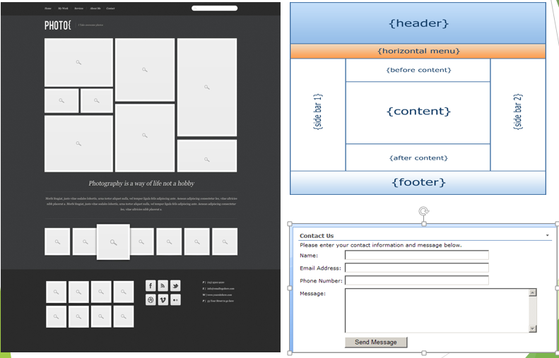
CSS3

